Slide 1
Algorithms: Divide and Conquer Algorithms
Computer Science, Purdue University
Copyright WILEY, Goodrich and Tamassia, Data Structures And Algorithms

Slide 2
Algorithms: Divide and Conquer Algorithms
Divide and Conquer Algorithms
Divide a given problem into smaller subproblems
Solve each subproblem (conquer)
We have seen examples of such algorithms: Quicksort!
Here, we give another example for solving the Closest Pair Problem
Computer Science, Purdue University

Slide 3
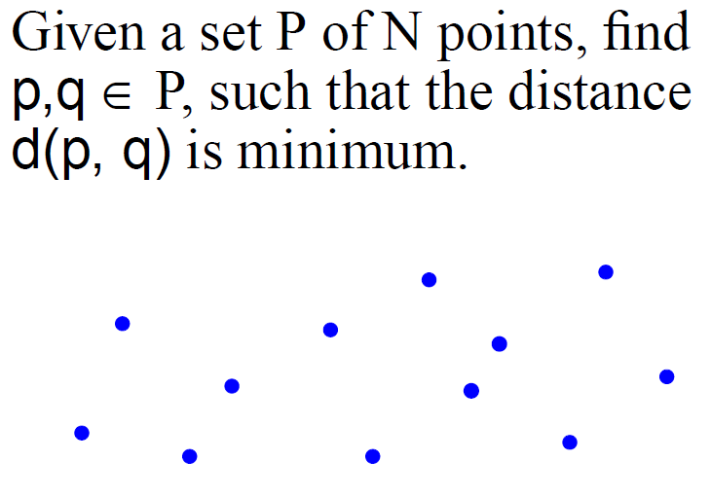
Algorithms: Divide and Conquer Algorithms
Closest Pair Problem
Computer Science, Purdue University

Slide 4
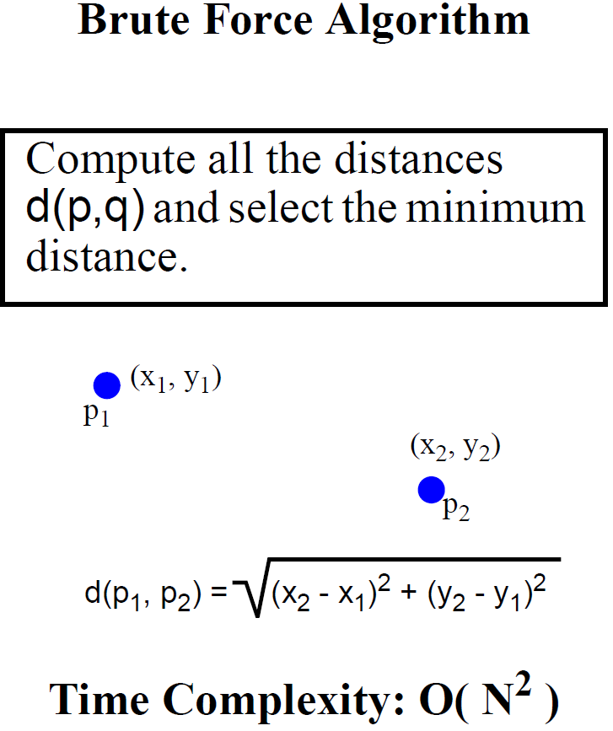
Algorithms: Divide and Conquer Algorithms
Closest Pair Problem
Computer Science, Purdue University

Slide 5
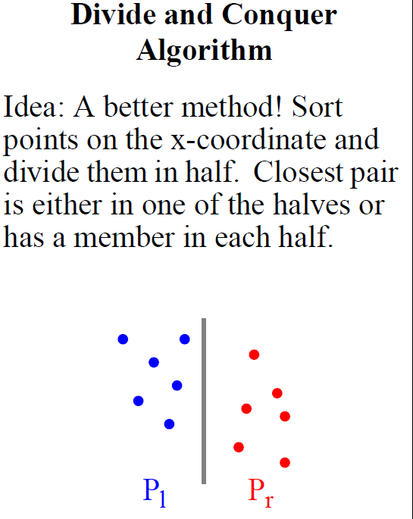
Algorithms: Divide and Conquer Algorithms
Closest Pair Problem
Computer Science, Purdue University

Slide 6
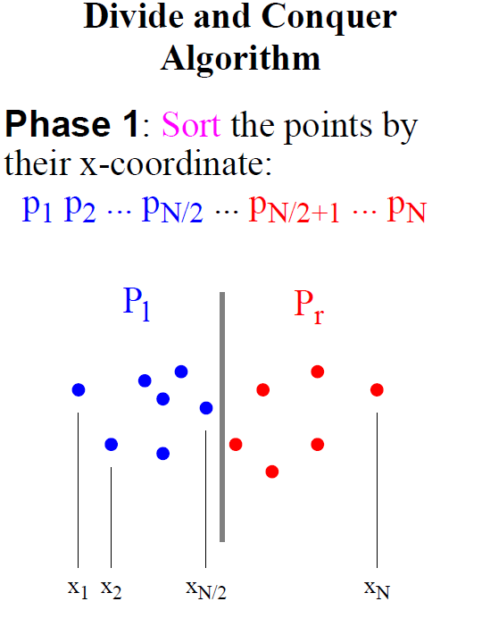
Algorithms: Divide and Conquer Algorithms
Closest Pair Problem
Computer Science, Purdue University

Slide 7
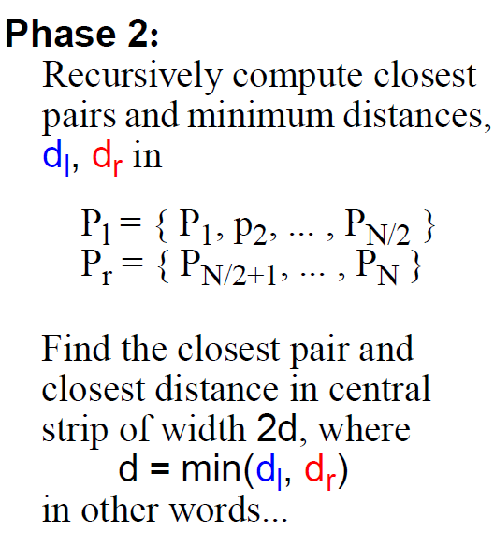
Algorithms: Divide and Conquer Algorithms
Closest Pair Problem
Computer Science, Purdue University

Slide 8
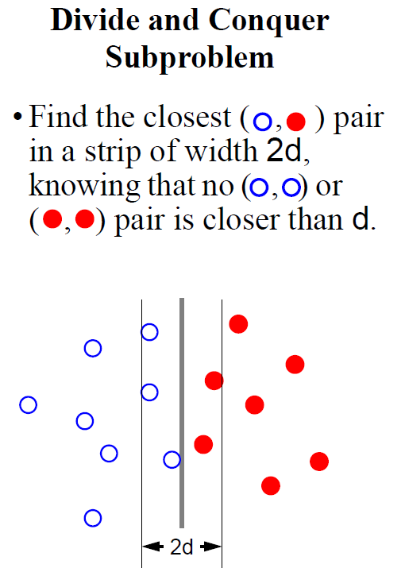
Algorithms: Divide and Conquer Algorithms
Closest Pair Problem
Computer Science, Purdue University

Slide 9
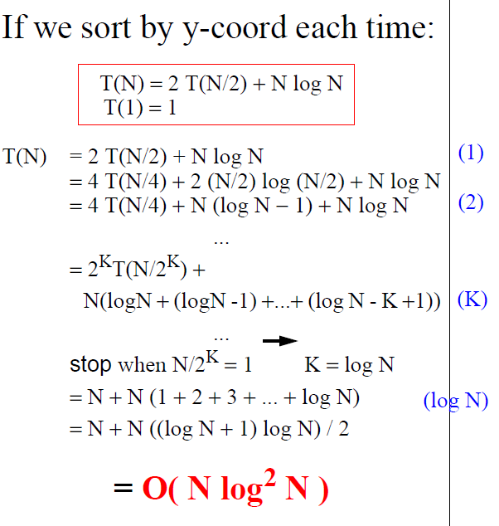
Algorithms: Divide and Conquer Algorithms
Closest Pair Problem
Computer Science, Purdue University

Slide 10
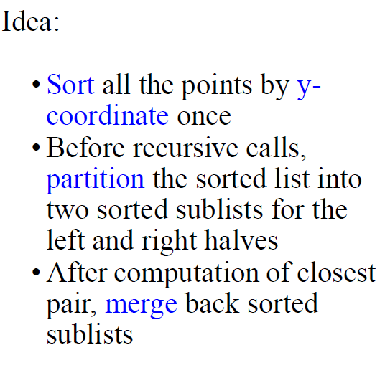
Algorithms: Divide and Conquer Algorithms
Closest Pair Problem
Computer Science, Purdue University

Slide 11
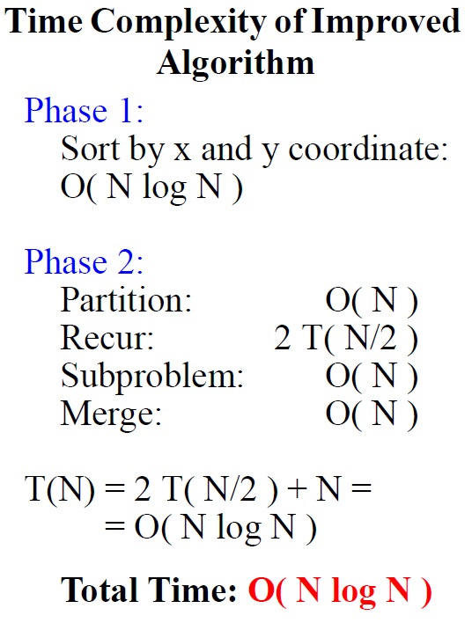
Algorithms: Divide and Conquer Algorithms
Closest Pair Problem
Computer Science, Purdue University

Slide 12
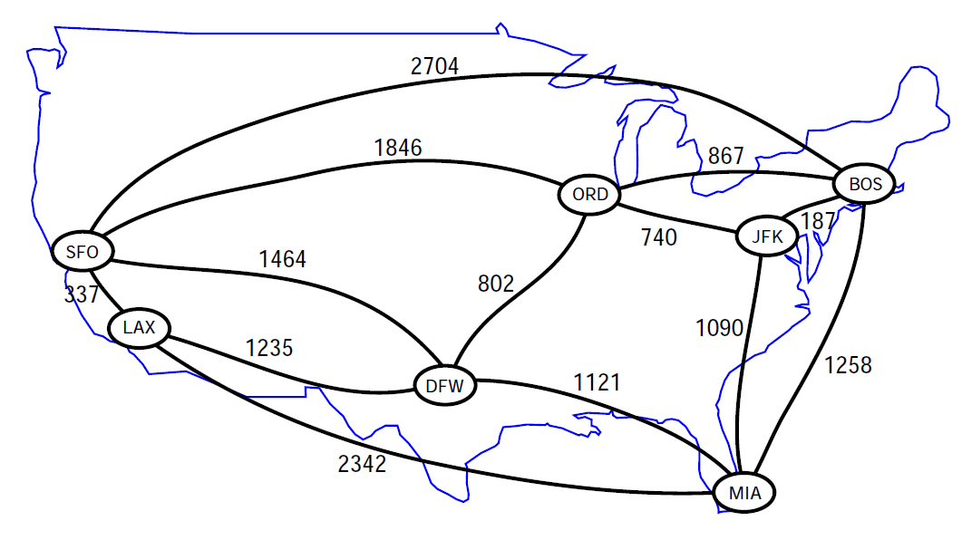
Algorithms: Greedy Algorithms
Shortest Paths in Graphs
Computer Science, Purdue University

Slide 13
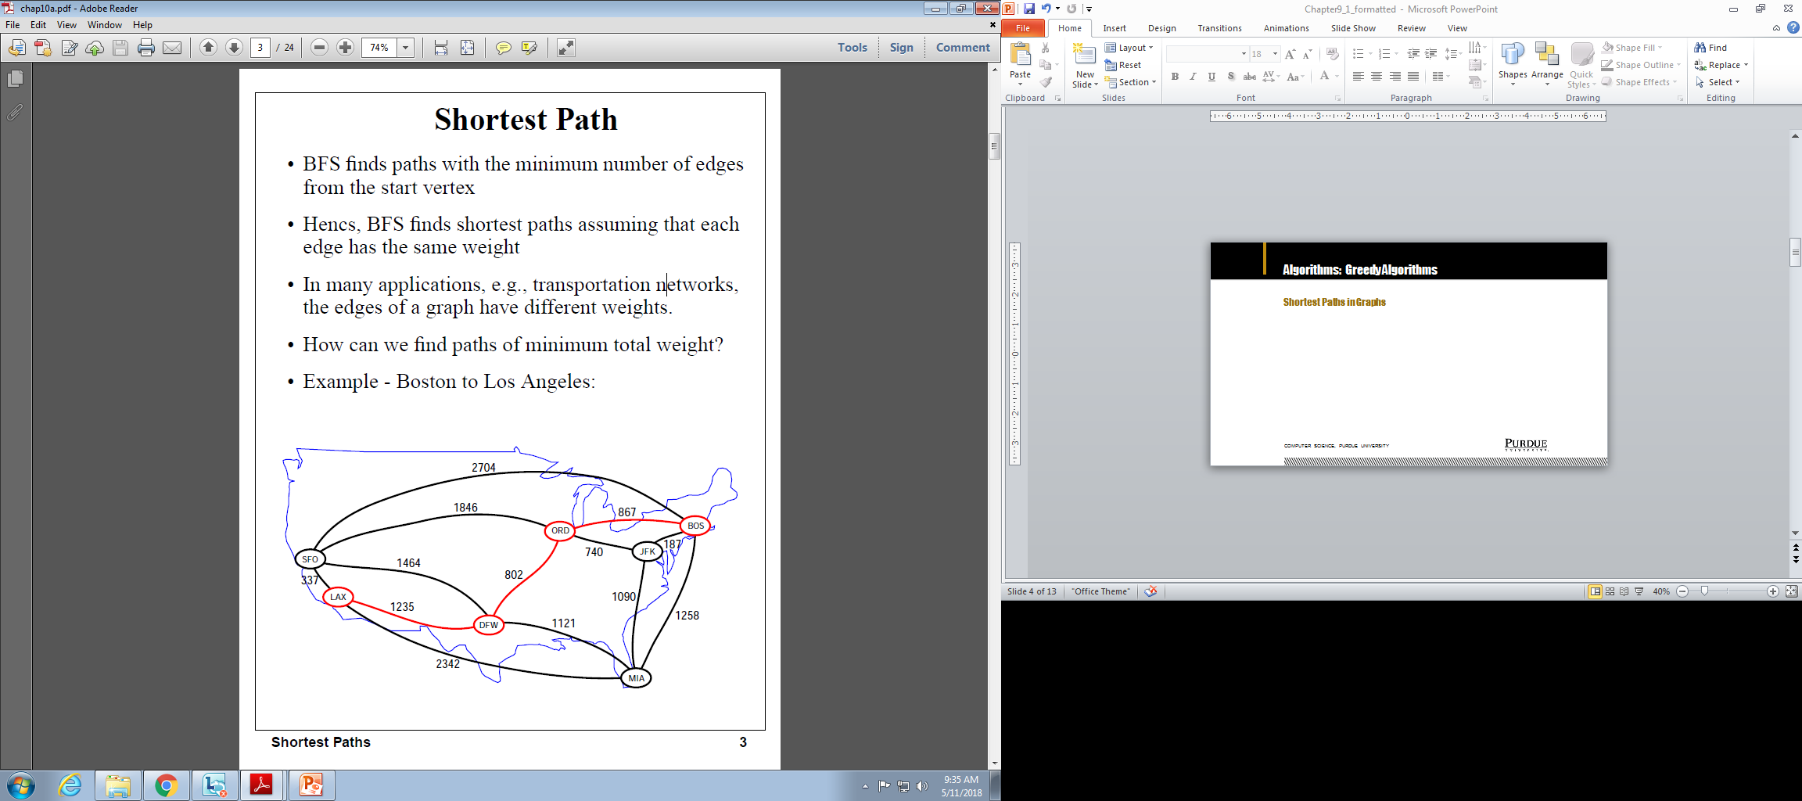
Algorithms: Greedy Algorithms
Shortest Paths in Graphs
Computer Science, Purdue University

Slide 14
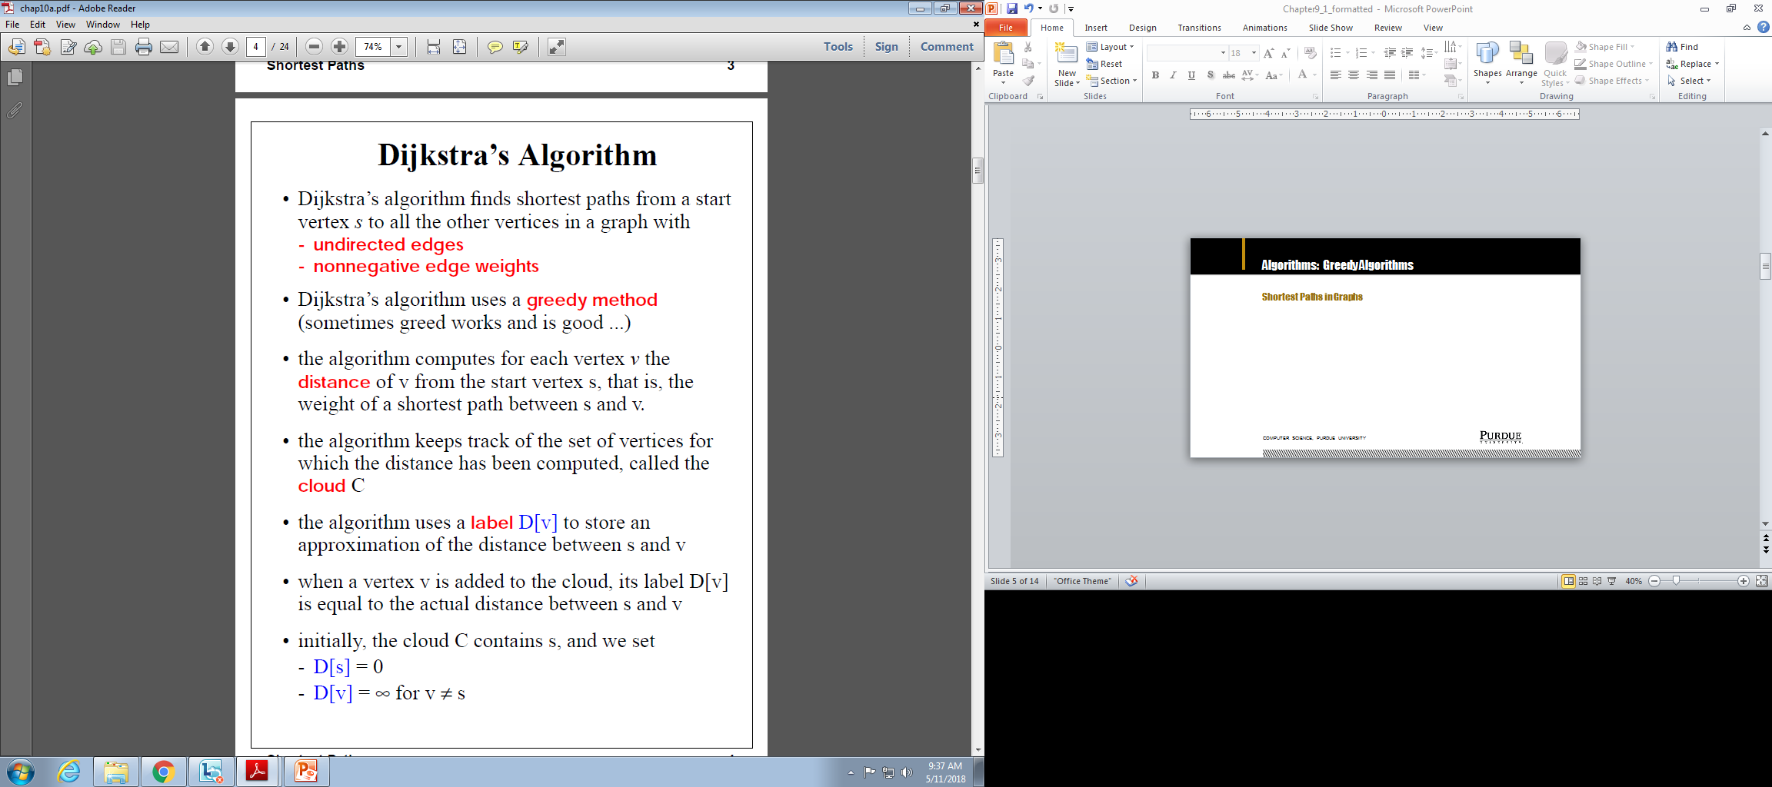
Algorithms: Greedy Algorithms
Shortest Paths in Graphs
Computer Science, Purdue University

Slide 15
Algorithms: Greedy Algorithms
Shortest Paths in Graphs: Dijkstra’s Algorithm
Computer Science, Purdue University

Slide 16
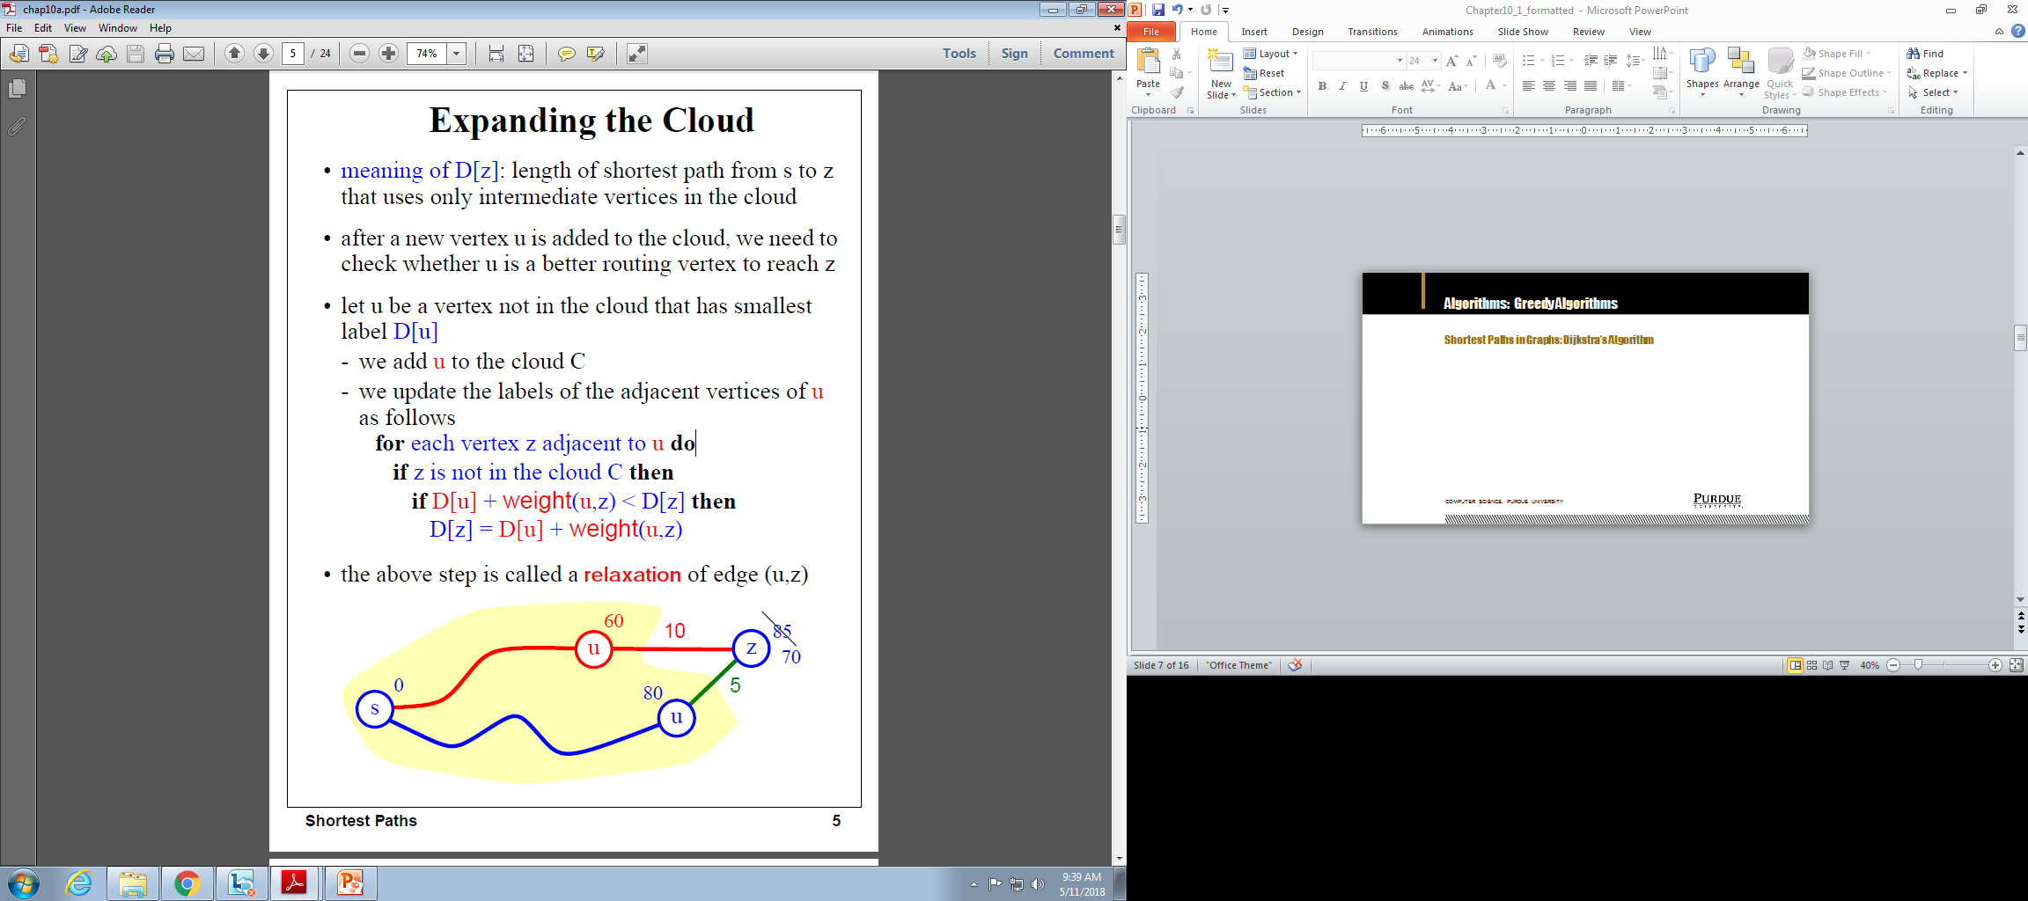
Algorithms: Greedy Algorithms
Shortest Paths in Graphs: Dijkstra’s Algorithm
Computer Science, Purdue University

Slide 17
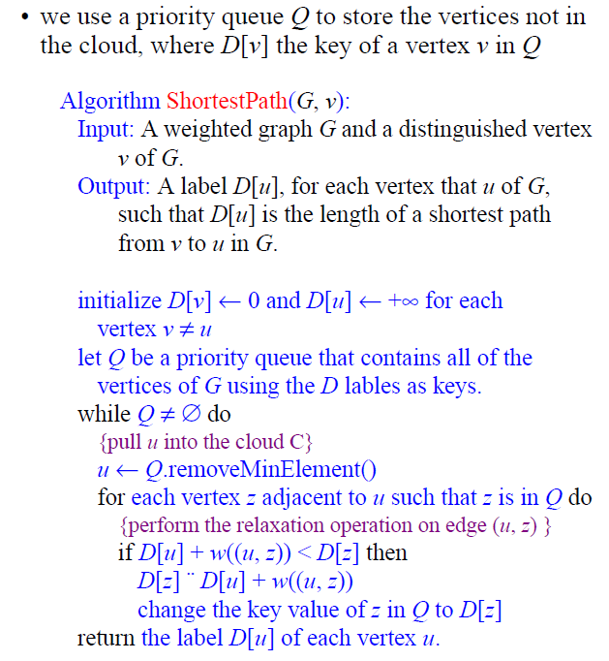
Algorithms: Greedy Algorithms
Shortest Paths in Graphs:
Dijkstra’s Algorithm
Computer Science, Purdue University

Slide 18
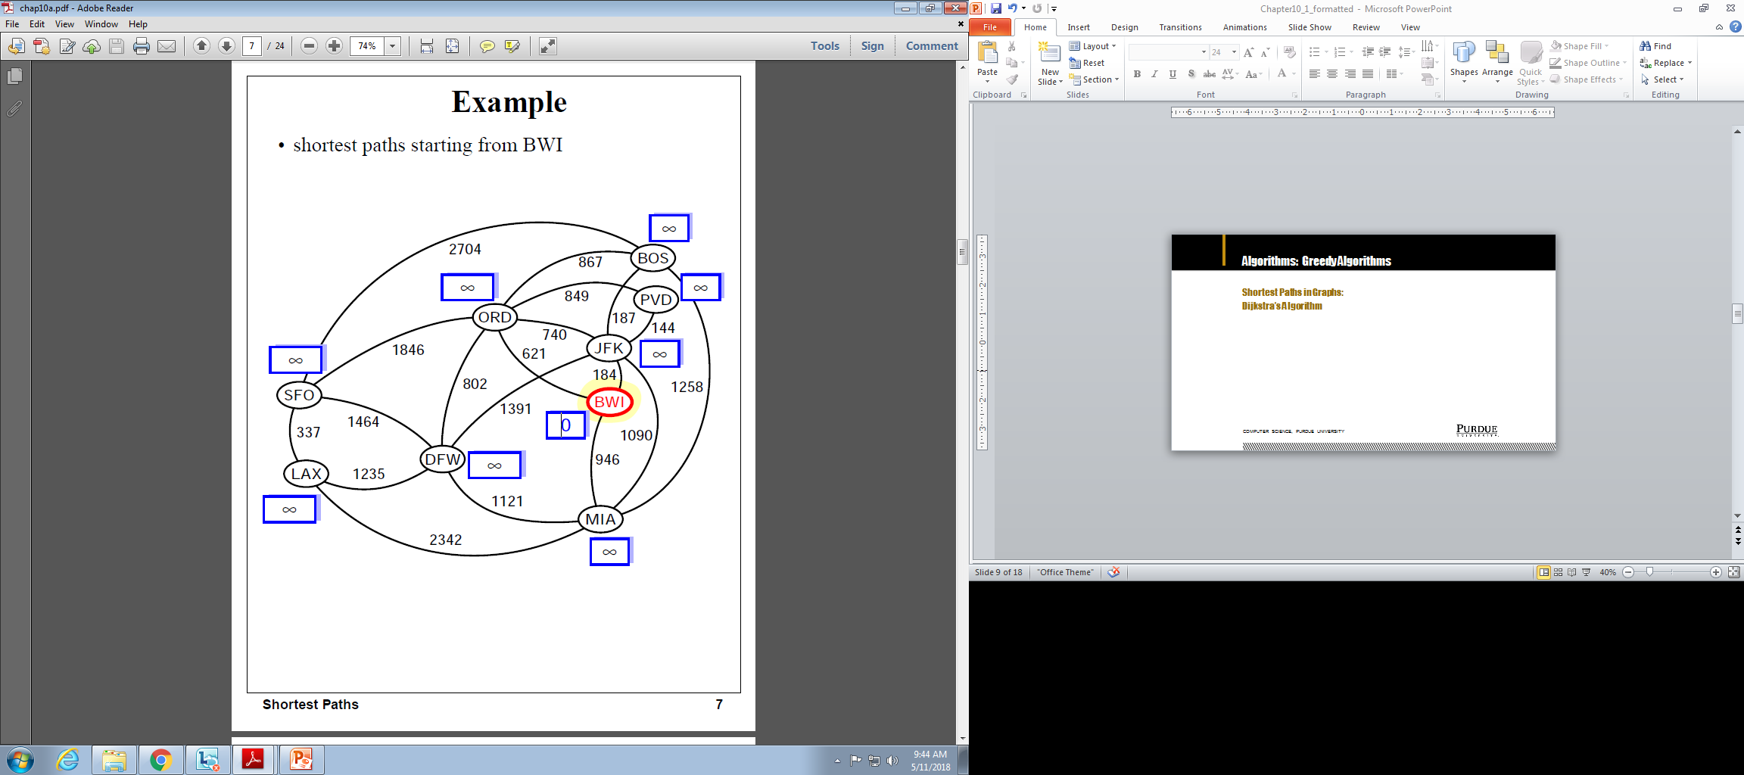
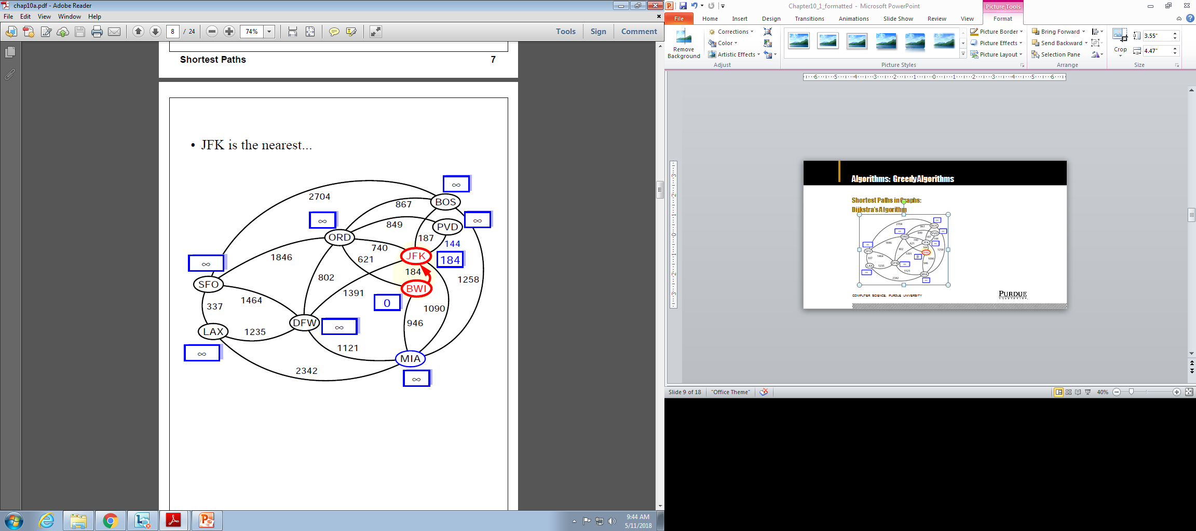
Algorithms: Greedy Algorithms
Shortest Paths in Graphs:
Dijkstra’s Algorithm
Computer Science, Purdue University

Slide 19
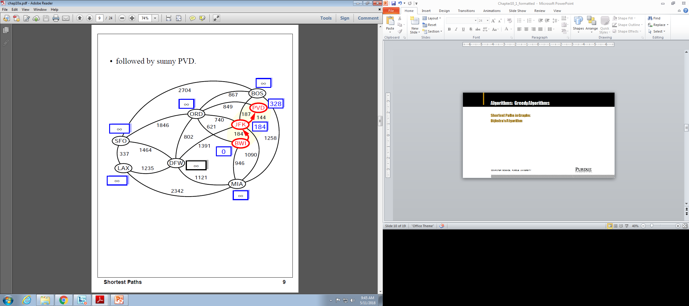
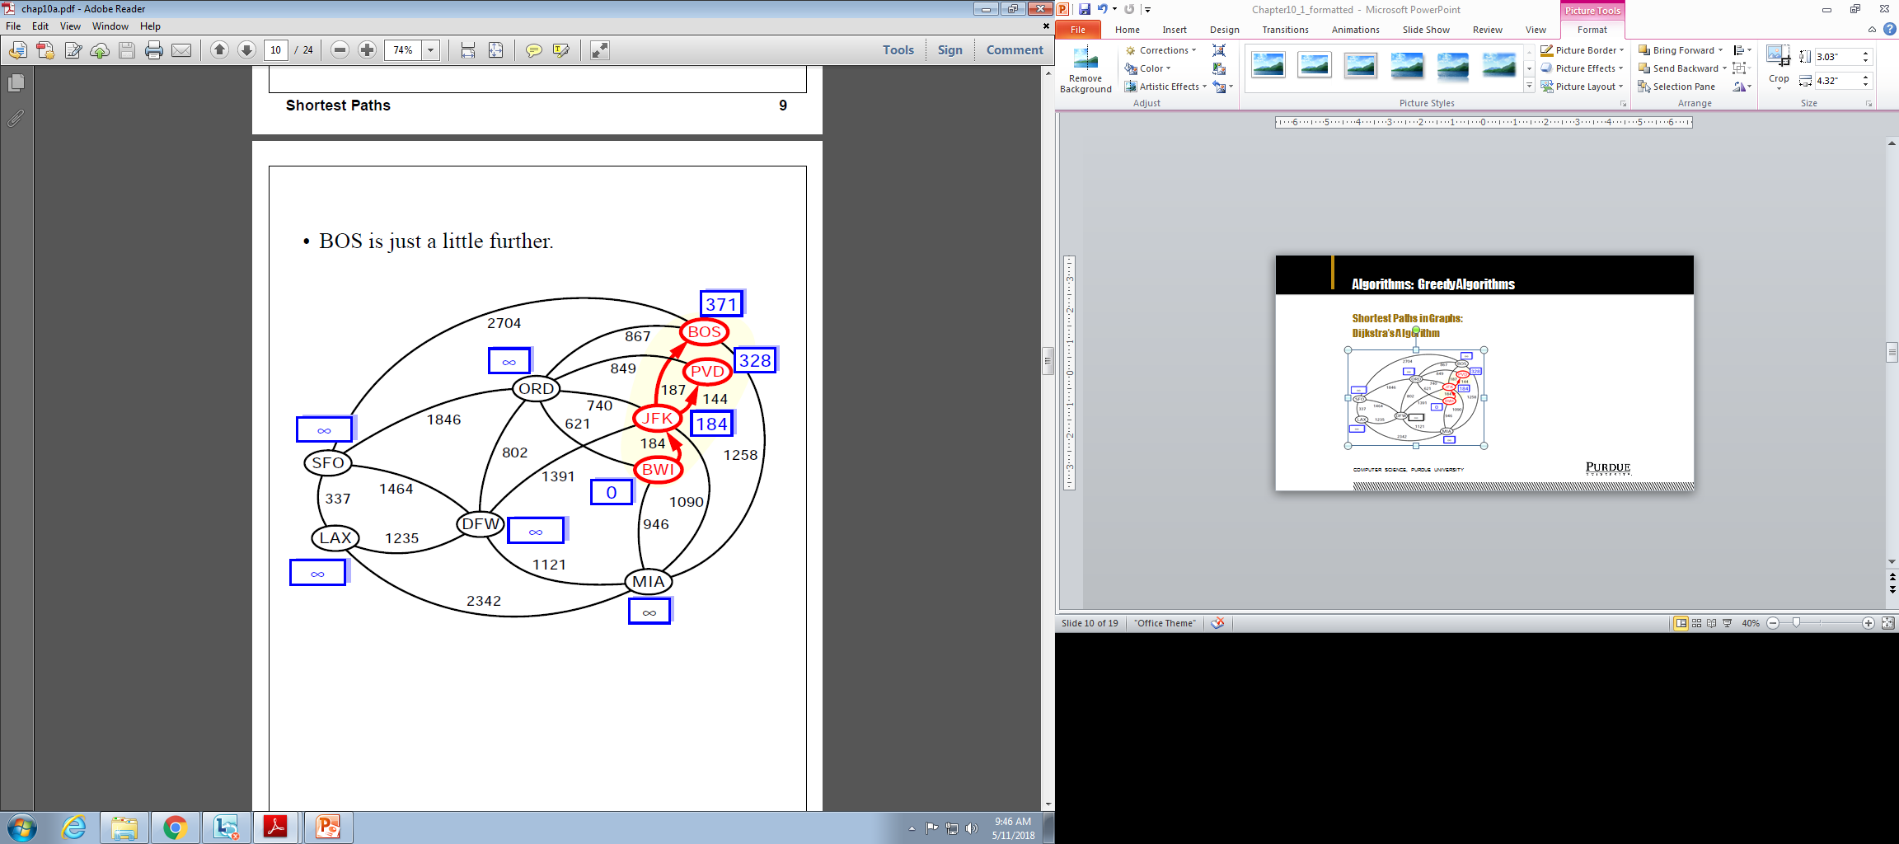
Algorithms: Greedy Algorithms
Shortest Paths in Graphs:
Dijkstra’s Algorithm
Computer Science, Purdue University

Slide 20
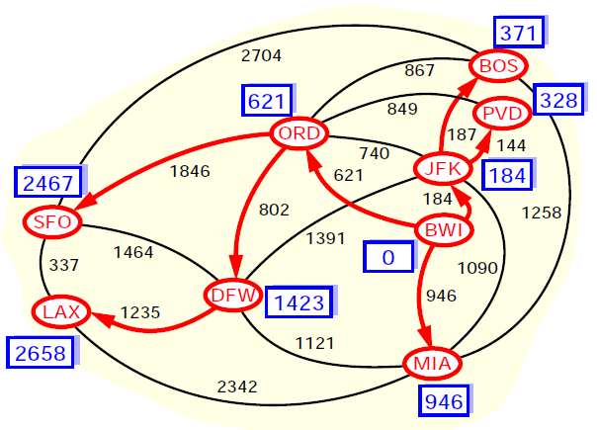
Algorithms: Greedy Algorithms
Shortest Paths in Graphs:
Dijkstra’s Algorithm
Computer Science, Purdue University

Slide 21
Algorithms: Greedy Algorithms
Shortest Paths in Graphs:
Dijkstra’s Algorithm
Computer Science, Purdue University

Slide 22
Algorithms: Greedy Algorithms
Shortest Paths in Graphs: Dijkstra’s Algorithm
Running Time
Let’s assume that we represent G with an adjacency list. We can then step through all the vertices adjacent to u in time proportional to their number (i.e. O(j) where j in the number of vertices adjacent to u)
The priority queue Q:
A Heap: Implementing Q with a heap allows for efficient extraction of vertices with the smallest D label(O(log N)). If Q is implemented with locators, key updates can be performed in O(log N) time. The total run time is O((n+m)log n) where n is the number of vertices in G and m in the number of edges. In terms of n, worst case time is O(n²log n)
Unsorted Sequence: O(n) when we extract minimum elements, but fast key updates (O(1)). There are only n-1 extractions and m relaxations. The running time is O(n²+m)
Computer Science, Purdue University

Slide 23
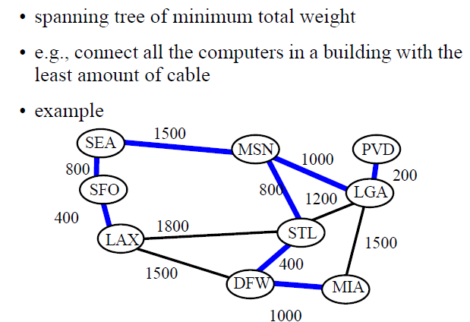
Algorithms: Greedy Algorithms
Minimum Spanning Tree
Computer Science, Purdue University

Slide 24
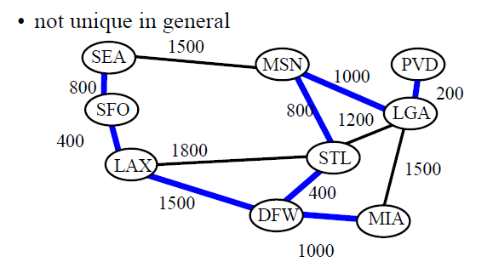
Algorithms: Greedy Algorithms
Minimum Spanning Tree
Computer Science, Purdue University

Slide 25
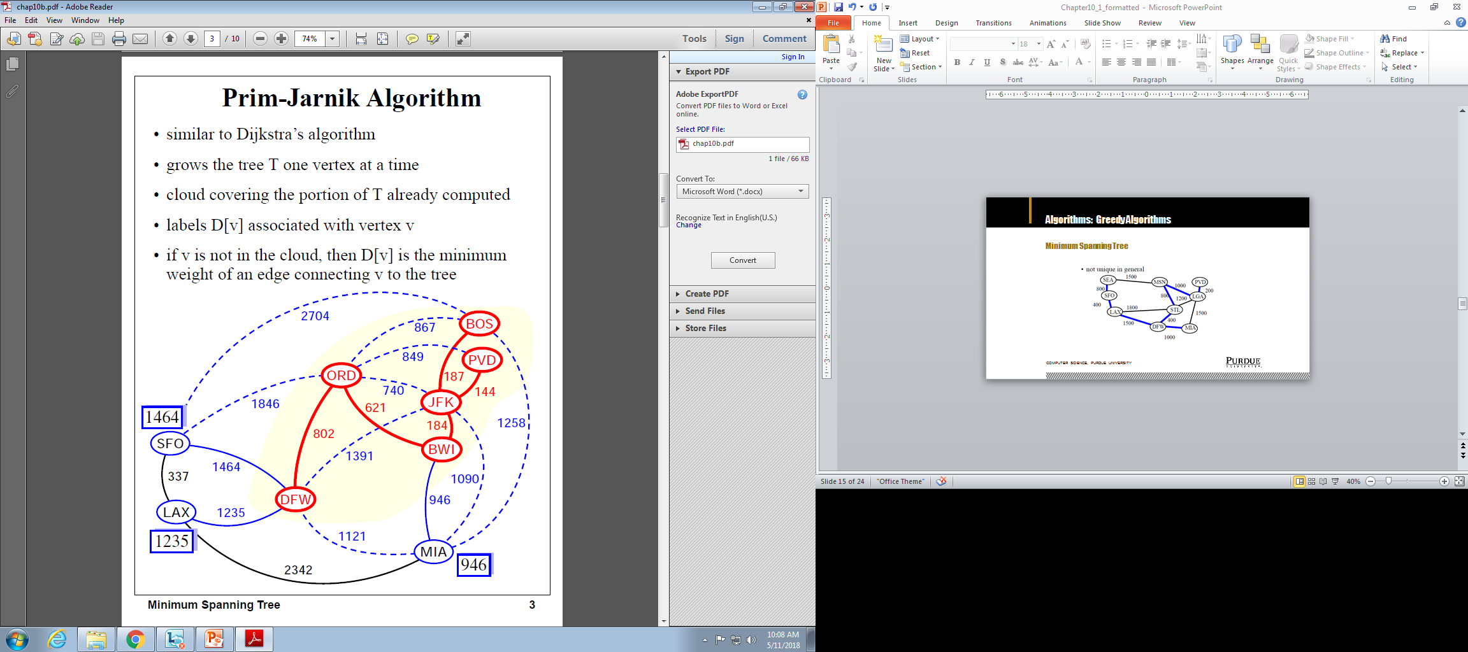
Algorithms: Greedy Algorithms
Minimum Spanning Tree
Computer Science, Purdue University

Slide 26
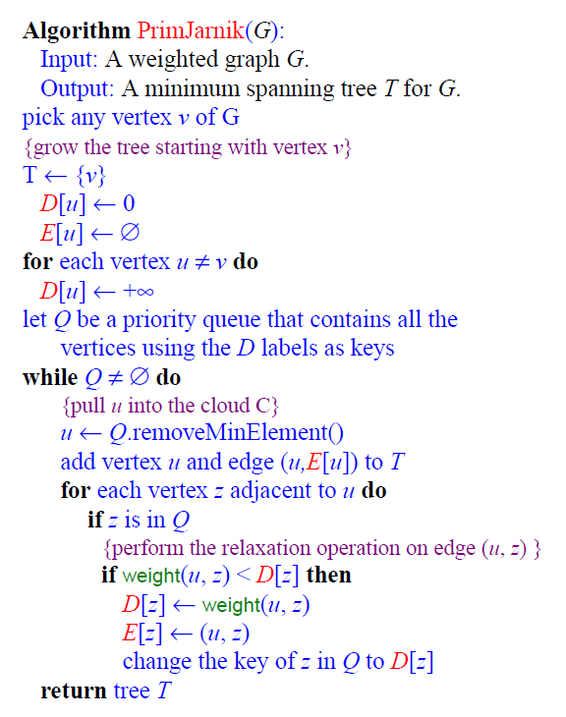
Algorithms: Greedy Algorithms
Minimum Spanning Tree:
Prim-Jarnik Algorithm
Runtime is same as the shortest path algorithms
Computer Science, Purdue University

Slide 27
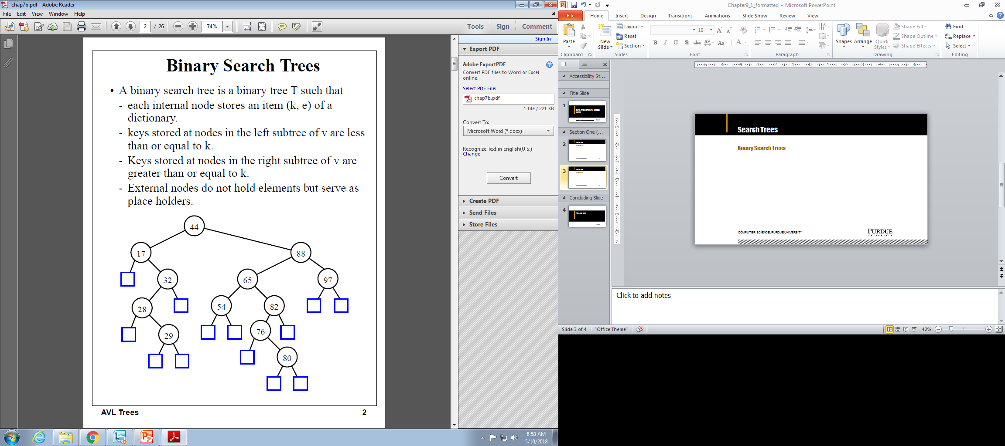
Search Trees
Binary Search Trees
Computer Science, Purdue University

Slide 28
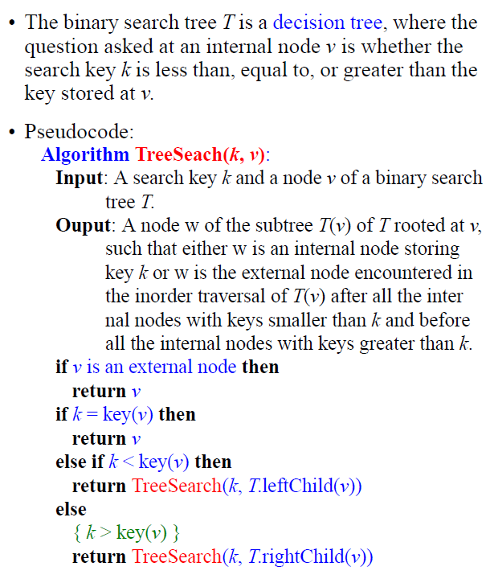
Search Trees
Binary Search Trees
Computer Science, Purdue University

Slide 29
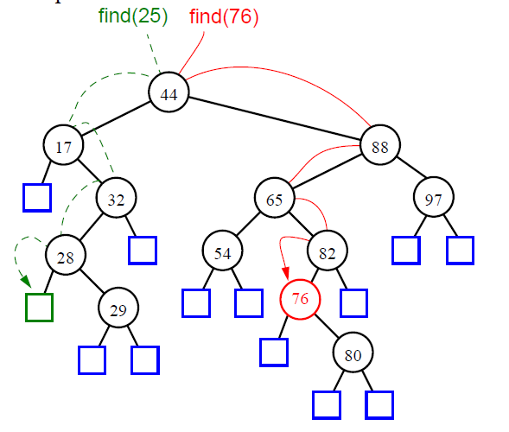
Search Trees
Binary Search Trees
Computer Science, Purdue University

Slide 30
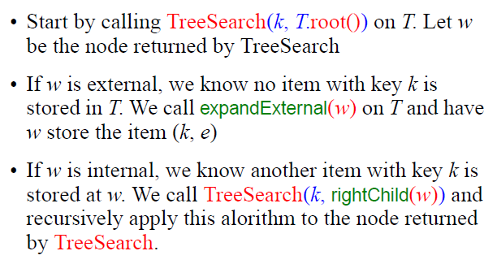
Search Trees
Binary Search Trees:
Insertion
Computer Science, Purdue University

Slide 31
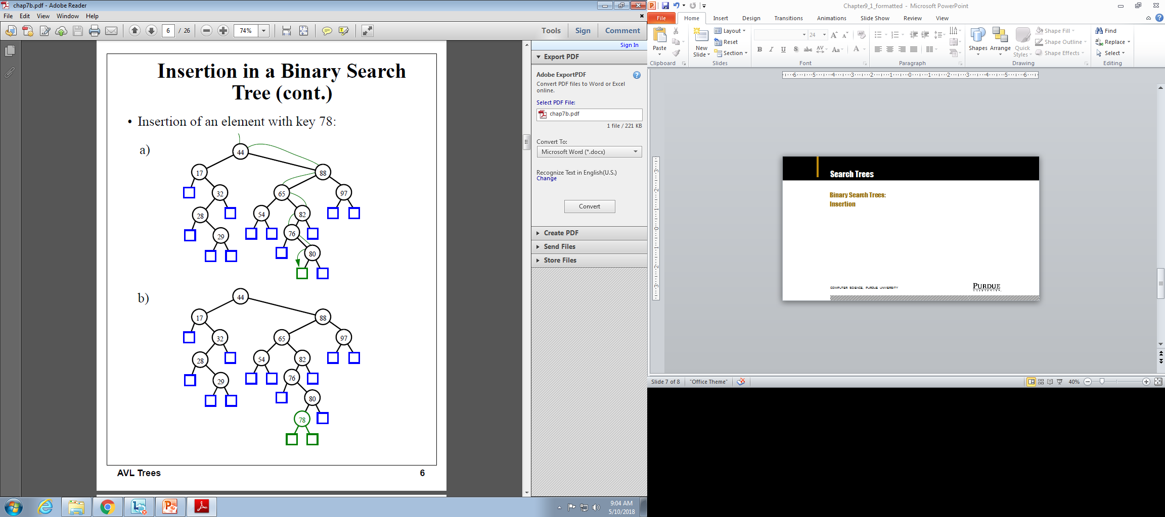
Search Trees
Binary Search Trees:
Insertion
Computer Science, Purdue University

Slide 32
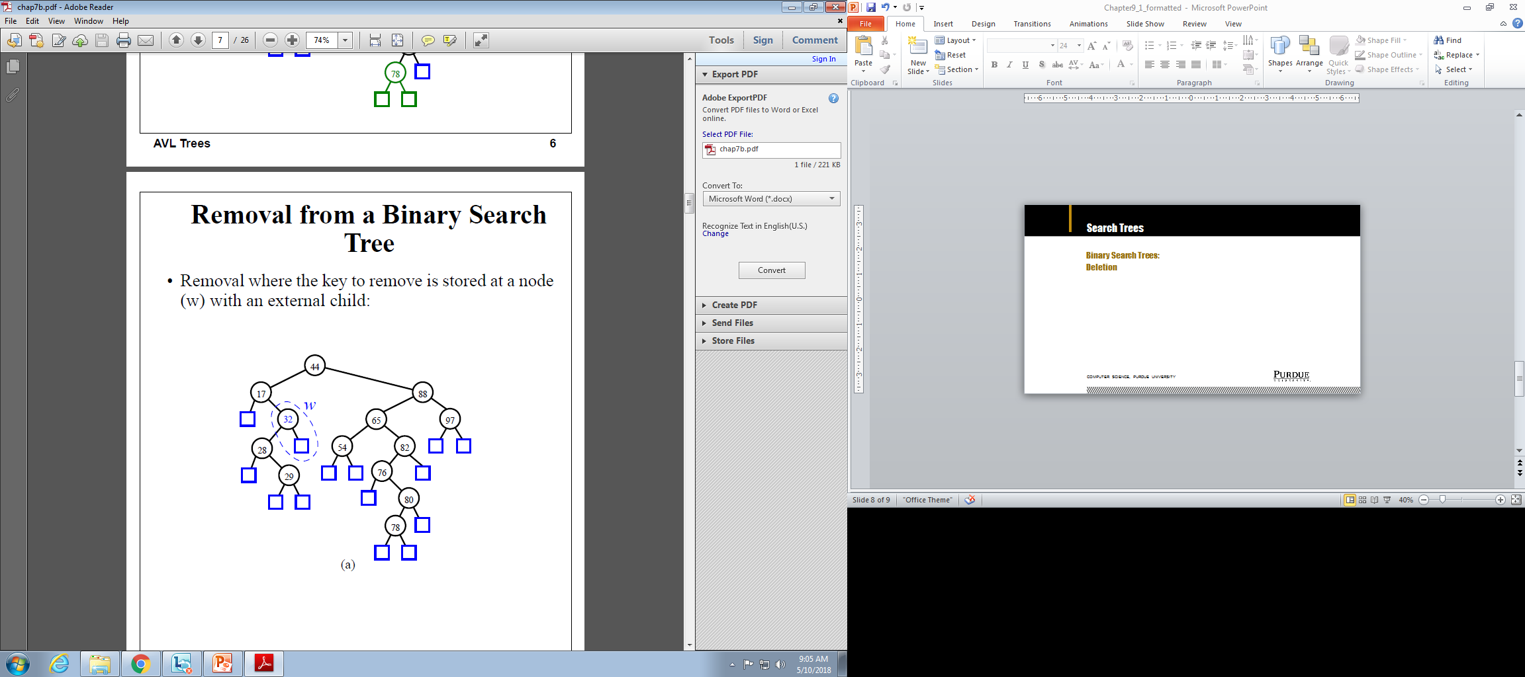

Search Trees
Binary Search Trees:
Deletion
Computer Science, Purdue University

Slide 33
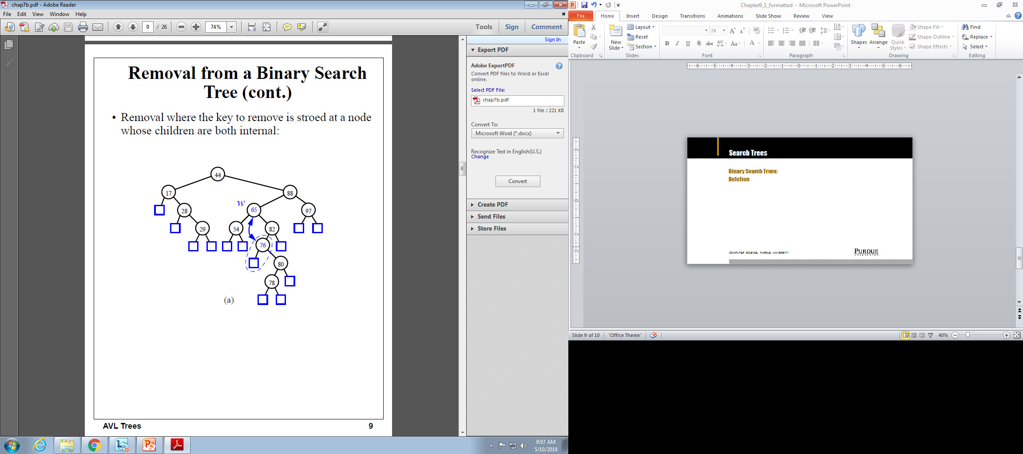
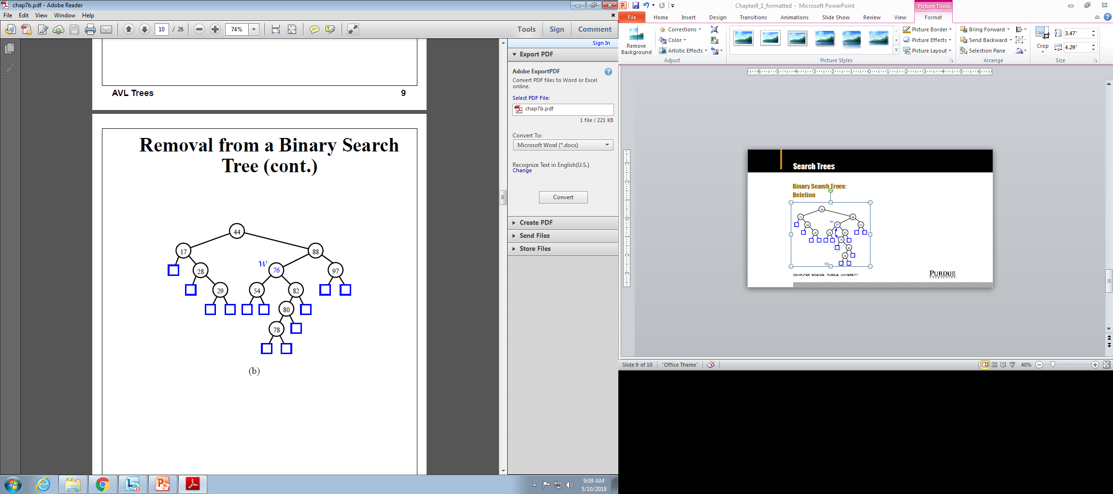
Search Trees
Binary Search Trees:
Deletion
Computer Science, Purdue University

Slide 34

Search Trees
Binary Search Trees: Time Complexity
Computer Science, Purdue University

Slide 35
Thank You

